Slide 1
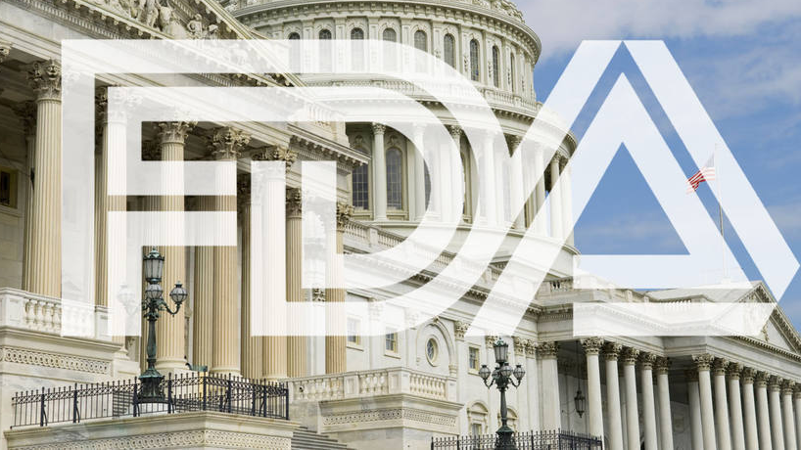
OneScan
https://www.cigaraficionado.com/article/lobbyists-increase-outreach-for-premium-cigar-exemption-19574

Slide 2

ENGG6400 Mobile Devices App Development
Group 5 Zimo Zhou (1189792), Yaowen Mei (1177855)

Slide 3
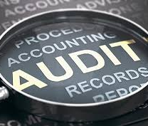
What is OneScan
OneScan is an App is to help an auditor to conduct a more efficient and more convenient audit for a medical device factory or automotive parts factory.
The auditor will need to open this app, scan an auditee’s equipment with back camera, then with machine learning technology, the app will show the auditor
the name of this equipment,
the standard operation procedure of this equipment, and
historical calibration record of this equipment.
https://www.accountancydaily.co/mg-opts-pwc-external-auditor

Slide 4
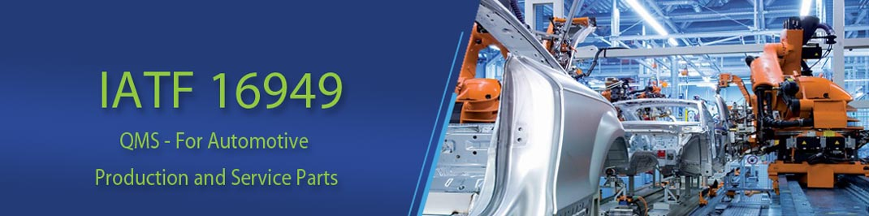
Why OneScan
Manufactories in North America are under strict regulation:
Automotive factories need to be audited by BIQS (IATF 16949-ISO 9001) for every 6 months if they make parts for GM and Ford,
Medical device factories need to be inspected at least every 2 years by a FDA inspector (ISO-13485) if they make medical devices.
Calibration is one of the auditor’s most interest questions[1]. The auditor’s time is very precious while the auditor’s knowledge is limited. Without knowing much details in the auditee’s Lab, our app (Machine learning + Database) can easily provide the auditor a lot of useful information:
What is the name of this device,
Has this device been calibrated before use,
How often should it be calibrated according to the standard operation procedure,
Where can I find the historical calibration record.
Reference:
[1] Services, R. S. C. (2018, July 6). Guide to FDA Requirements and Importance of Medical Device Calibration. Tech Briefs. https://www.medicaldesignbriefs.com/component/content/article/mdb/tech-briefs/29754.

Slide 5
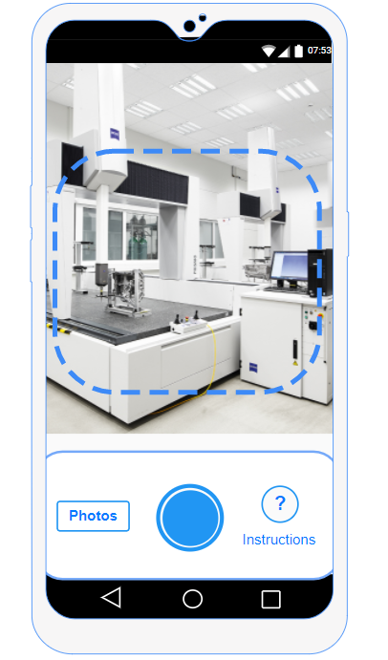
Mock-up
--- Home Screen
User can take a picture with this app
Or choose a photo from the album
Or see the instructions about how the app is going to work
3
1
2

Slide 6
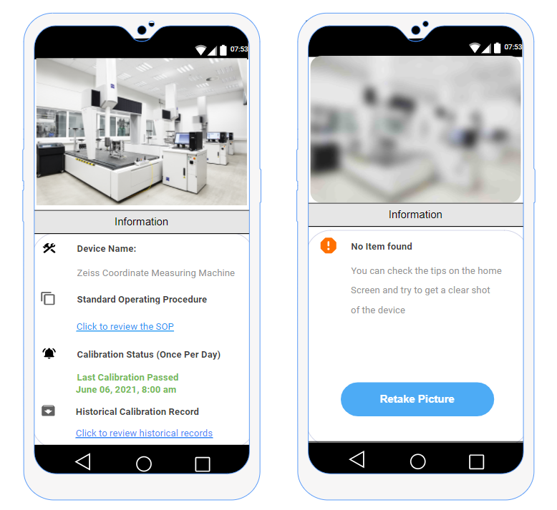
Mock-up
--- 1) Take a picture
If the device is recognized, the calibration information of this device will then be generated from the data base. Green for good to use, Red for out of calibration
If the picture is blurry, device can not be recognized, an error message will be generated, so user can retake the picture

Slide 7
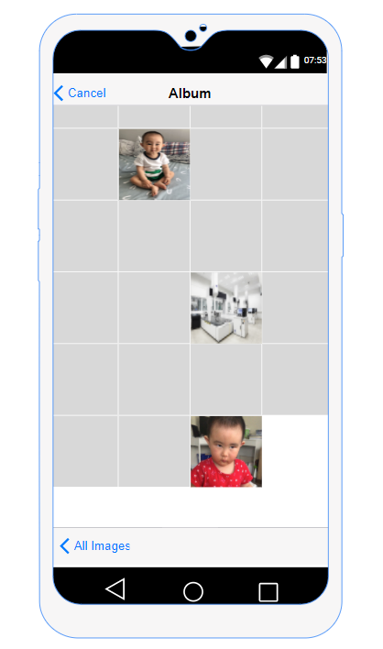
Mock-up
--- 2) Select from Album
User can also take pictures from the album

Slide 8
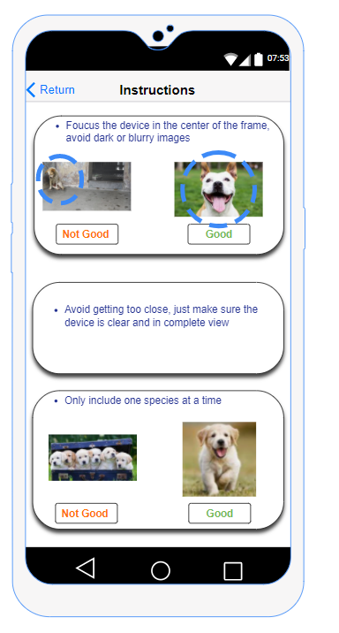
Mock-up
--- 3) Instruction
The user should be able to use this app by intuition, but just in case, some instructions are aslo provided for the user:
Focus and put target in the center
Only picture one object at a time

Slide 9
Block Diagram
Home Screen
3
2
1
Select Image from Album
Take a picture
Show Instruction
Picture Clear
Blurry
Retake Pic
Get Status from Database

Slide 10
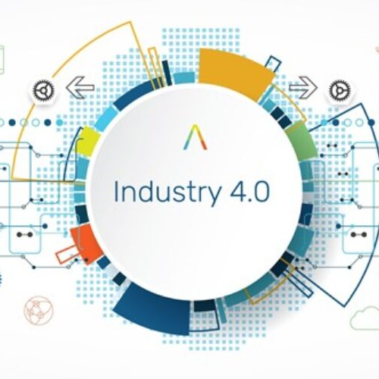
Expected Outcome
With OneScan, quality assurance in North America can be improved in the long term:
the auditor can conduct more efficient/accurate auditing,
patients and car owners can have better quality products,
factories will have less recalls
North America’s quality assurance system can then achieve the next level and will keep ahead in the Fourth Industrial Revolution (Industry4.0).

Slide 11
The End. Thank you!

